Slide 1
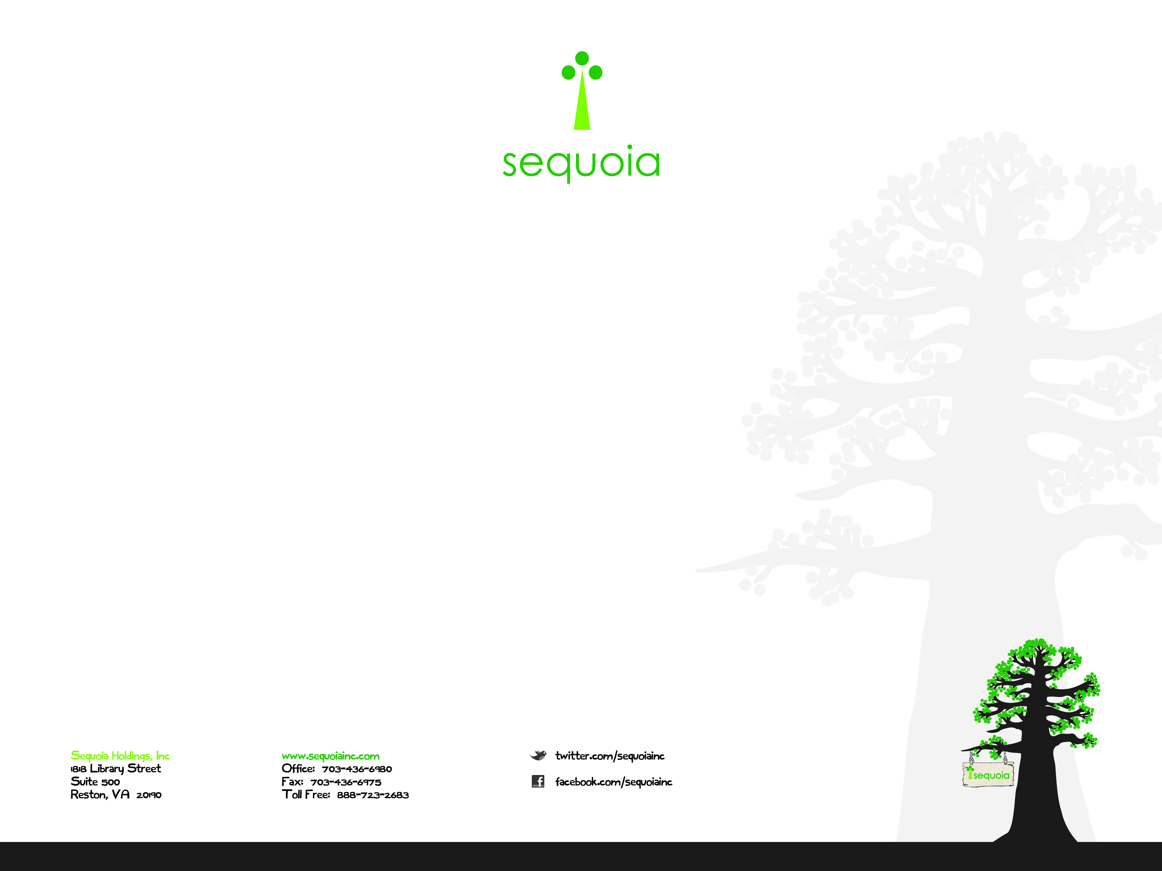
AWS Use Case
by Stephen Mouring
Notes:
<number>

Slide 2
A Transition Story
Text
Sequoia Holdings, Inc Proprietary and Confidential

